Slide 1
The Western Mind [7]
RUC, SPRING 2017

Slide 2
PART ONE

Slide 3
ESSAY QUESTIONS
CHOOSE ONE ESSSAY TOPIC
1. Compare and contrast Kant’s understanding of ‘enlightenment’ in his ‘What is Enlightenment?’ (1784) with Foucault’s understanding of the term in his work with the same title (1984).
2. Analyze some of the ways in which Edmund Husserl’s phenomenology and/or Martin Heidegger’s metaphysics influenced the philosophy of Emmanuel Levinas and/or Jacques Derrida.
3. Compare and contrast a Western thinker with a Chinese thinker you have studied.

Slide 4
EXAM QUESTIONS 1
PLEASE ANSWER THREE QUESTIONS IN THE TIME ALLOWED (one and a half hours)
1. What is the nature of Charles Taylor's critique of contemporary Western moral philosophy?
2. Either: How does Plato understand life before birth?
(see Phaedrus)
Or: Where does Plato think the source of true knowledge lies?
(see Phaedrus)

Slide 5
EXAM QUESTIONS 2
3. Either: What do you think Aristotle means by 'being'?
(see Metaphysics)
Or: What role does 'reason' play in Aristotle's thinking about the human?
(see Nichomachean Ethics)
4. Either: What are the implications of Augustine naming God as 'unchanging Being'? Is this Platonism, Christianity, both or neither?
(see the Confessions)
Or: How does Thomas Aquinas link metaphysics with the Christian doctrine of God the Creator?
(see Summa theologiae)

Slide 6
EXAM QUESTIONS 3
5. Either: What kind of theory of language emerges from Eckhart's Sermon 5?
Or: How does philosophy change when a medieval thinker produces philosophy in the form of a spoken sermon and in the German language?
6. Why does Descartes' philosophy begin in radical doubt and how good is this as a place to start?
(see the Meditation II)
7. How does Kant define 'enlightenment' in ‘What is Enlightenment?’. [Please do not choose the second question if you answered the essay question on Kant]

Slide 7
EXAM QUESTIONS 4
8. Either: Set out your understanding of Heidegger’s metaphysics as developed in his Introduction to Metaphysics.
Or: Analyze some of the ways in which Levinas or Derrida, or both, critically responded to Kant’s metaphysics.
[Please do not choose either of these questions if you answered the essay question on Heidegger]
9. Discuss how any one modern Western philosopher has influenced any one modern Western religious thinker.

Slide 8
EXAM QUESTIONS 5
10. Compare and contrast any one Western thinker you have studied on this course with any one Chinese thinker.
[Please do not choose this question if you have written an essay on it]
11. Either: Defend the idea that there is a distinctively Western ‘mind’, and define its characteristics on the basis of the texts you have studied.
Or: Offer a refutation of the idea that there is really a distinctively Western mind.

Slide 9
THE ELEMENTS OF THE WESTERN TRADITION
Greek beginnings: different languages (Hebrew and Latin)
Polarisation (dialectic and dialogue). Proximity (Plato and Aristotle)
Texts survived sometimes not in their original languages
Commentarial traditions
Christianity and Judaism (with some Islam, in Spain)
Constant redefinition of borders between religion and philosophy (initially classical)
Encounter with science.
Multiplication of languages with Romanticism.
Extensive conflict within Europe. Political dialectic.
Continental philosophy reabsorbs religious thematics (i.e. negativity)
Science changes

Slide 10
PART TWO

Slide 11
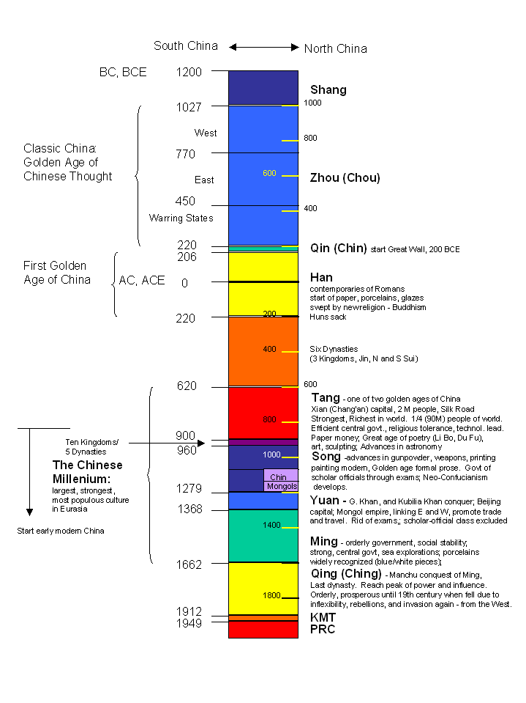
SCIENCE IN THE WEST 1
HISTORY OF CHINA

Slide 12
SCIENCE IN THE WEST 2
HISTORY OF THE WEST
THE ‘BUFFERED’ AND THE ‘POROUS’ SELF (CH. TAYLOR)
PRE-MODERN
EARLY MODERN
MODERN
post-modern

Slide 13
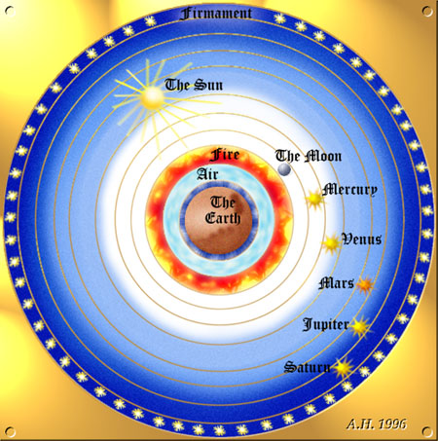
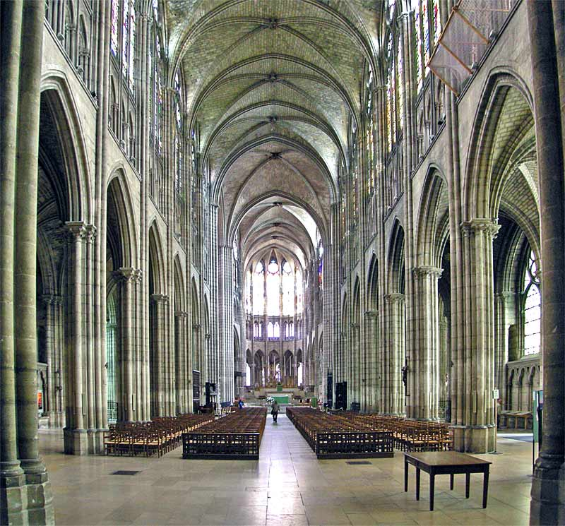
SCIENCE IN THE WEST 3

Slide 14
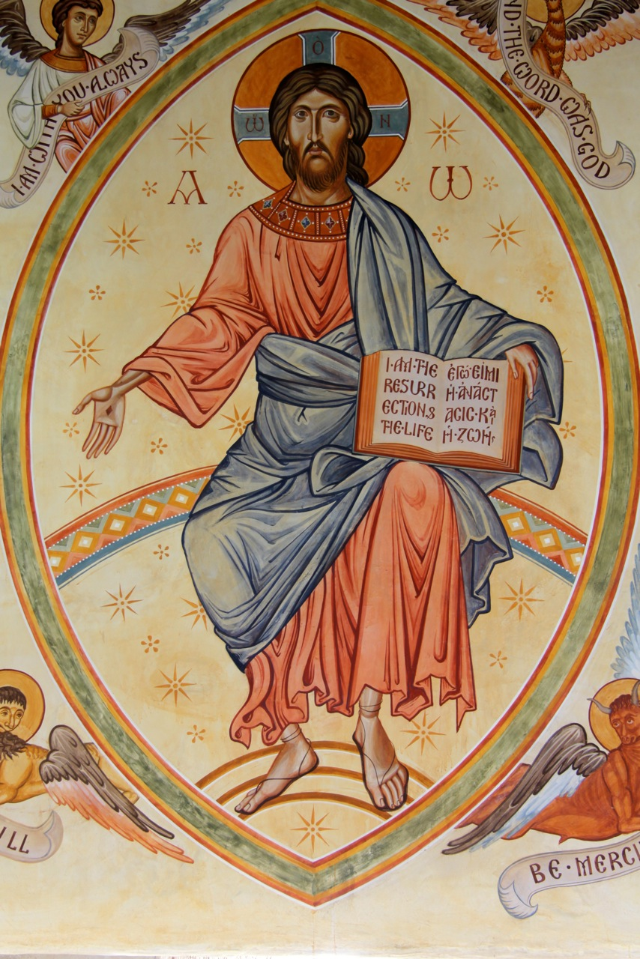
SCIENCE IN THE WEST 4

Slide 15
SCIENCE IN THE WEST 5
A body is necessarily:
‘circumscribed, limited and
particular’
Ulrich Zwingli, 1528

Slide 16
SCIENCE IN THE WEST 6
Scepticism, rationalism, fatalism,
Romanticism, Idealism, empiricism
Turn to the subject
Turn to language

Slide 17
SCIENCE IN THE WEST 7
HISTORY OF THE WEST
THE ‘BUFFERED’ AND THE ‘POROUS’ SELF (CH. TAYLOR)
PRE-MODERN
EARLY MODERN
MODERN
post-modern

Slide 18
PART THREE

Slide 19
CHARLES TAYLOR (Chapter 1.4) 1
Thus far I have been exploring only one strand of our moral intuitions, albeit an extremely important one. These are the moral beliefs which cluster around the sense that human life is to be respected and that the prohibitions and obligations which this imposes on us are among the most weighty and serious in our lives. I have been arguing that there is a peculiarly modern sense of what respect involves, which gives a salient place to freedom and self-control, places a high priority on avoiding suffering, and sees productive activity and family life as central to our well-being. But this cluster of moral intuitions lies along only one of the axes of our moral life. There are others to which the moral notions that I have been discussing are also relevant.
'Morality', of course, can be and often is defined purely in terms of respect for others. The category of the moral is thought to encompass just our obligations to other people. B.ut if we adopt this definition, then we have to allow that there are other questions beyond the moral which are of central concern to us, and which bring strong evaluation into play. There are questions about how I am going to live my life which touch on the issue of what kind of life is worth living, or what kind of life would fulfill the promise implicit in my particular talents, or the demands incumbent on someone with my endowment, or of what constitutes a rich, meaningful life-as against one concerned with secondary matters or trivia.

Slide 20
CHARLES TAYLOR (Chapter 1.4) 2
These are issues of strong evaluation, because the people who ask these questions have no doubt that one can, following ones immediate wishes and desires, take a wrong turn and hence fail to lead a full life. To understand our moral world we have to see not only what ideas and pictures underlie our sense of respect for others but also those which underpin our notions of a full life. And as we shall see, these are not two quite separate orders of ideas. There is a substantial overlap or, rather, a complex relation in which some of the same basic notions reappear in a new way. This is particularly the case for what I called above the affirmation of ordinary life.
In general, one might try to single out three axes of what can be called, in the most general sense, moral thinking. As well as the two just mentioned­ our sense of respect for and obligations to others, and our understandings of what makes a full life-there is also the range of notions concerned with dignity. By this I mean the characteristics by which we think of ourselves as commanding (or failing to command) the respect of those around us.

Slide 21
CHARLES TAYLOR (Chapter 1.4) 3
Our 'dignity', in the particular sense I am using it here, is our sense of ourselves as commanding (attitudinal) respect. The issue of what one's dignity consists in is no more avoidable than those of why we ought to respect others' rights or what makes a full life, however much a naturalist philosophy might mislead us into thinking of this as another domain of mere 'gut' reactions, similar to those of baboons establishing their hierarchy. And in this case, its unavoidability ought to be the more obvious in that our dignity is so much woven into our very comportment. The very way we walk, move, gesture, speak is shaped from the earliest moments by our awareness that we appear before others, that we stand in public space, and that this space is potentially one of respect or contempt, of pride or shame. Just what do we see our dignity consisting in? It can be our power, our sense of dominating public space; or our invulnerability to power; or our self-sufficiency, our life having its own centre; or our being liked and looked to by others, a centre of attention.

Slide 22
CHARLES TAYLOR (Chapter 1.4) 4
But very often the sense of dignity can ground in some of the same moral views I mentioned above. For instance, my sense of myself as a householder, father of a family, holding down a job, providing for my dependants; all this can be the basis of my sense of dignity. Just as its absence can be catastrophic, can shatter it by totally undermining my feeling of self-worth. Here the sense of dignity is woven into this modern notion of the importance of ordinary life, which reappears again on this axis.
One of the most important ways in which our age stands out from earlier ones concerns the second axis. A set of questions make sense to us which turn around the meaning of life and which would not have been fully understand­ able in earlier epochs. Moderns can anxiously doubt whether life has meaning, or wonder what its meaning is. However philosophers may be inclined to attack these formulations as vague or confused, the fact remains that we all have an immediate sense of what kind of worry is being articulated in these words.

Slide 23
CHARLES TAYLOR (Chapter 1.4) 5
It is now a commonplace about the modern world that it has made these frameworks problematic. On the level of explicit philosophical or theological doctrine, this is dramatically evident. Some traditional frameworks are discredited or downgraded to the status of personal predilection, like the space of fame. Others have ceased to be credible altogether in anything like their original form, like the Platonic notion of the order of being. The forms of revealed religion continue very much alive, but also highly contested. None forms the horizon of the whole society in the modern West.

Slide 24
CHARLES TAYLOR (Chapter 1.4) 6
This term 'horizon' is the one that is frequently used to make this point. What Weber called 'disenchantment', the dissipation of our sense of the cosmos as a meaningful order, has allegedly destroyed the horizons in which people previously lived their spiritual lives. Nietzsche used the term in his celebrated "God is dead" passage: "How could we drink up the sea? Who gave us the sponge to wipe away the whole horizon?" Perhaps this way of putting it appeals above all to the intellectuals, who put a lot of stock in the explicit doctrines that people subscribe to, and anyway tend to be unbelievers. But the loss of horizon described by Nietzsche's fool undoubtedly corresponds to something very widely felt in our culture.

Slide 25
CHARLES TAYLOR (Chapter 1.4) 7
This is what I tried to describe with the phrase above, that frameworks today are problematic. This vague term points towards a relatively diversity of attitudes. What is common to them all is the sense that no framework is shared by everyone, can be taken for granted as the framework as such, can sink to the phenomenological status of unquestioned fact. This basic understanding refracts differently in the stances people take. For some it may mean holding a definite traditionally defined view with the self-conscious sense of standing against a major part of one's compatriots. Others may hold the view but with a pluralist sense that it is one among others, right for us but not necessarily binding on them. Still others identify with a view but in the somewhat tentative, semi-provisional way I described above in section 1.2. This seems to them to come close to formulating what they believe, or to saying what for them seems to be the spiritual source they can connect their lives with; but they are aware of their own uncertainties, of how far they are from being able to recognize a definitive formulation with ultimate confidence. They may see themselves, as, in a sense, seeking. They are on a 'quest', in Alasdair MacIntyre’s apt phrase!

Slide 26
CHARLES TAYLOR (Chapter 1.4) 8
With these seekers, of course, we are taken beyond the range of traditionally available frameworks. Not only do they embrace these traditions tentatively, but they also often develop their own versions of them, or idiosyncratic combinations of or borrowings from or semi-inventions within them. And this provides the context within which the question of meaning has its place.
To the extent that one sees the finding of a believable framework as the object of a quest, to that extent it becomes intelligible that the search might fail. This might happen through personal inadequacy, but failure might also come from there being no ultimately believable framework. Why speak of this in terms of a loss of meaning? Partly because a framework is that in virtue of which we make sense of our lives spiritually. Not to have a framework is to fall into a life which is spiritually senseless. The quest is thus always a quest for sense.

Slide 27
CHARLES TAYLOR (Chapter 1.4) 9
The problem of the meaning of life is therefore on our agenda, however much we may object to this phrase, either in the form of a threatened loss of meaning or because making sense of our life is the object of a quest. And those whose spiritual agenda is mainly defined in this way are in a fundamentally different existential predicament from that which dominated most previous cultures and still defines the lives of other people today. That alternative is a predicament in which an unchallengeable framework makes imperious demands which we fear being unable to meet. We face the prospect of irretrievable condemnation or exile, of being sent to damnation irrevocably, or being relegated to a lower order through countless future lives. The pressure is potentially immense and inescapable, and we may crack under it. The form of the danger here is utterly different from that which threatens the modern seeker, which is something dose to the opposite: the world loses altogether its spiritual contour, nothing is worth doing, the fear is of a terrifying emptiness, a kind of vertigo, or even a fracturing of our world and body-space.

Slide 28
CHARLES TAYLOR (Chapter 2) 10
To articulate a framework is to explicate what makes sense of our moral responses. That is, when we try to spell out what it is that we presuppose when we judge that a certain form of life is truly worthwhile, or place our dignity in a certain achievement or status, or define our moral obligations in a certain manner, we find ourselves articulating inter alia what I have been calling here 'frameworks’…..
Perhaps the best way to see this is to focus on the issue that we usually describe today as the question of identity. We speak of it in these terms because the question is often spontaneously phrased by people in the form: Who am I? But this can't necessarily be answered by giving name and genealogy. What does answer this question for us is an understanding of what is of crucial importance to us. To know who I am is a species of knowing where I stand. My identity is defined by the commitments and identifications which provide the frame or horizon within which I can try to determine from case to case what is good, or valuable, or what ought to be done, or what I endorse or oppose. In other words, it is the horizon within which I am capable of taking a stand.

Slide 29
CHARLES TAYLOR (Chapter 2.) 11
To articulate a framework is to explicate what makes sense of our moral responses. That is, when we try to spell out what it is that we presuppose when we judge that a certain form of life is truly worthwhile, or place our dignity in a certain achievement or status, or define our moral obligations in a certain manner, we find ourselves articulating inter alia what I have been calling here 'frameworks’…..
Perhaps the best way to see this is to focus on the issue that we usually describe today as the question of identity. We speak of it in these terms because the question is often spontaneously phrased by people in the form: Who am I? But this can't necessarily be answered by giving name and genealogy. What does answer this question for us is an understanding of what is of crucial importance to us. To know who I am is a kind of knowing where I stand. My identity is defined by the commitments and identifications which provide the frame or horizon within which I can try to determine from case to case what is good, or valuable, or what ought to be done, or what I endorse or oppose. In other words, it is the horizon within which I am capable of taking a stand.

Slide 30
CHARLES TAYLOR (Chapter 2.) 12
Of course, there is a big difference between the situation, on one hand, where I work out where I stand in conversation only with my immediate historic community and where I don't feel confirmed in what I believe unless we see eye to eye, and the case, on the other hand, where I rely mainly on a community of the like-minded, and where confirmation can take the form of my being satisfied that they give unwitting testimony to my views, that their thought and language bespeak contact with the same reality, which I see clearer than they. The gap gets even bigger when we reflect that in the latter case, the 'conversation' will no longer be exclusively with living contempo­raries, but will include, e.g., prophets, thinkers, writers who are dead. What is the point of my insisting that the thesis about interlocution holds in spite of this gap?

Slide 31
CHARLES TAYLOR (Chapter 2.) 13
The point is to insist on what I might call this 'transcendental' condition of our having a grasp on our own language, that we in some fashion confront it or relate it to the language of others. This is not just a recommended policy of the kind that suggests if you check your beliefs against others' you'll avoid some falsehoods. In speaking of a 'transcendental' condition here, I am pointing to the way in which the very confidence that we know what we mean, and hence our having our own original language, depends on this relating. The original and inescapable context of such relating is the face-to-face one in which we actually agree. We are inducted into language by being brought to see things as our tutors do. Later, and only for part of our language, we can deviate, and this thanks to our relating to absent partners as well and to our confronting our thought with any partner in this new, indirect way, through a reading of the disagreement. And even here, not all the confronting can be through dissent.

Slide 32
CHARLES TAYLOR (Chapter 2.) 14
My life always has this degree of narrative understanding, that I understand my present action in the form of an 'and then': there was A (what I am), and then I do B (what I project to become). But narrative must play a bigger role than merely structuring my present. What I am has to be understood as what I have become.

Slide 33
CHARLES TAYLOR (Chapter 2.) 15
In the previous section we saw that our being selves is essentially linked to our sense of the good, that we achieve selfhood among other selves. Here I’ve been arguing that the issue of how we are placed in relation to this good is of crucial, inescapable concern for us, that we cannot but strive to give our lives meaning or substance, and that this means that we understand ourselves inescapably in narrative.
My underlying thesis is that there is a close connection between the different conditions of identity, or of one's life making sense, that I have been discussing. One could put it this way: because we cannot but orient ourselves to the good, and thus determine our place relative to it and hence determine the direction of our lives, we must inescapably understand our lives in narrative form, as a 'quest'. But one could perhaps start from another point: because we have to determine our place in relation to the good, therefore we cannot be without an orientation to it, and hence must see our life in story. From whichever direction, I see these conditions as connected facets of the same reality, inescapable structural requirements of human agency.

